Slide 1
Ch. 33
Aggregate Demand and Aggregate Supply

Slide 2
Look for the answers to these questions:
What are economic fluctuations? What are their characteristics?
How does the model of aggregate demand and aggregate supply explain economic fluctuations?
Why does the Aggregate-Demand curve slope downward? What shifts the AD curve?
What is the slope of the Aggregate-Supply curve in the short run? In the long run? What shifts the AS curve(s)?

Slide 3
Introduction
Real GDP over the long run
Grows about 3% per year on average
GDP in the short run
Fluctuates around its trend
Recessions
Periods of falling real incomes and rising unemployment
Depressions
Severe recessions (very rare)

Slide 4
Economic Fluctuations,
Three key facts about economic fluctuations
Economic fluctuations are irregular and unpredictable
The business cycle
Most macroeconomic quantities fluctuate together
Recessions: economy-wide phenomena
As output falls, unemployment rises

Slide 5
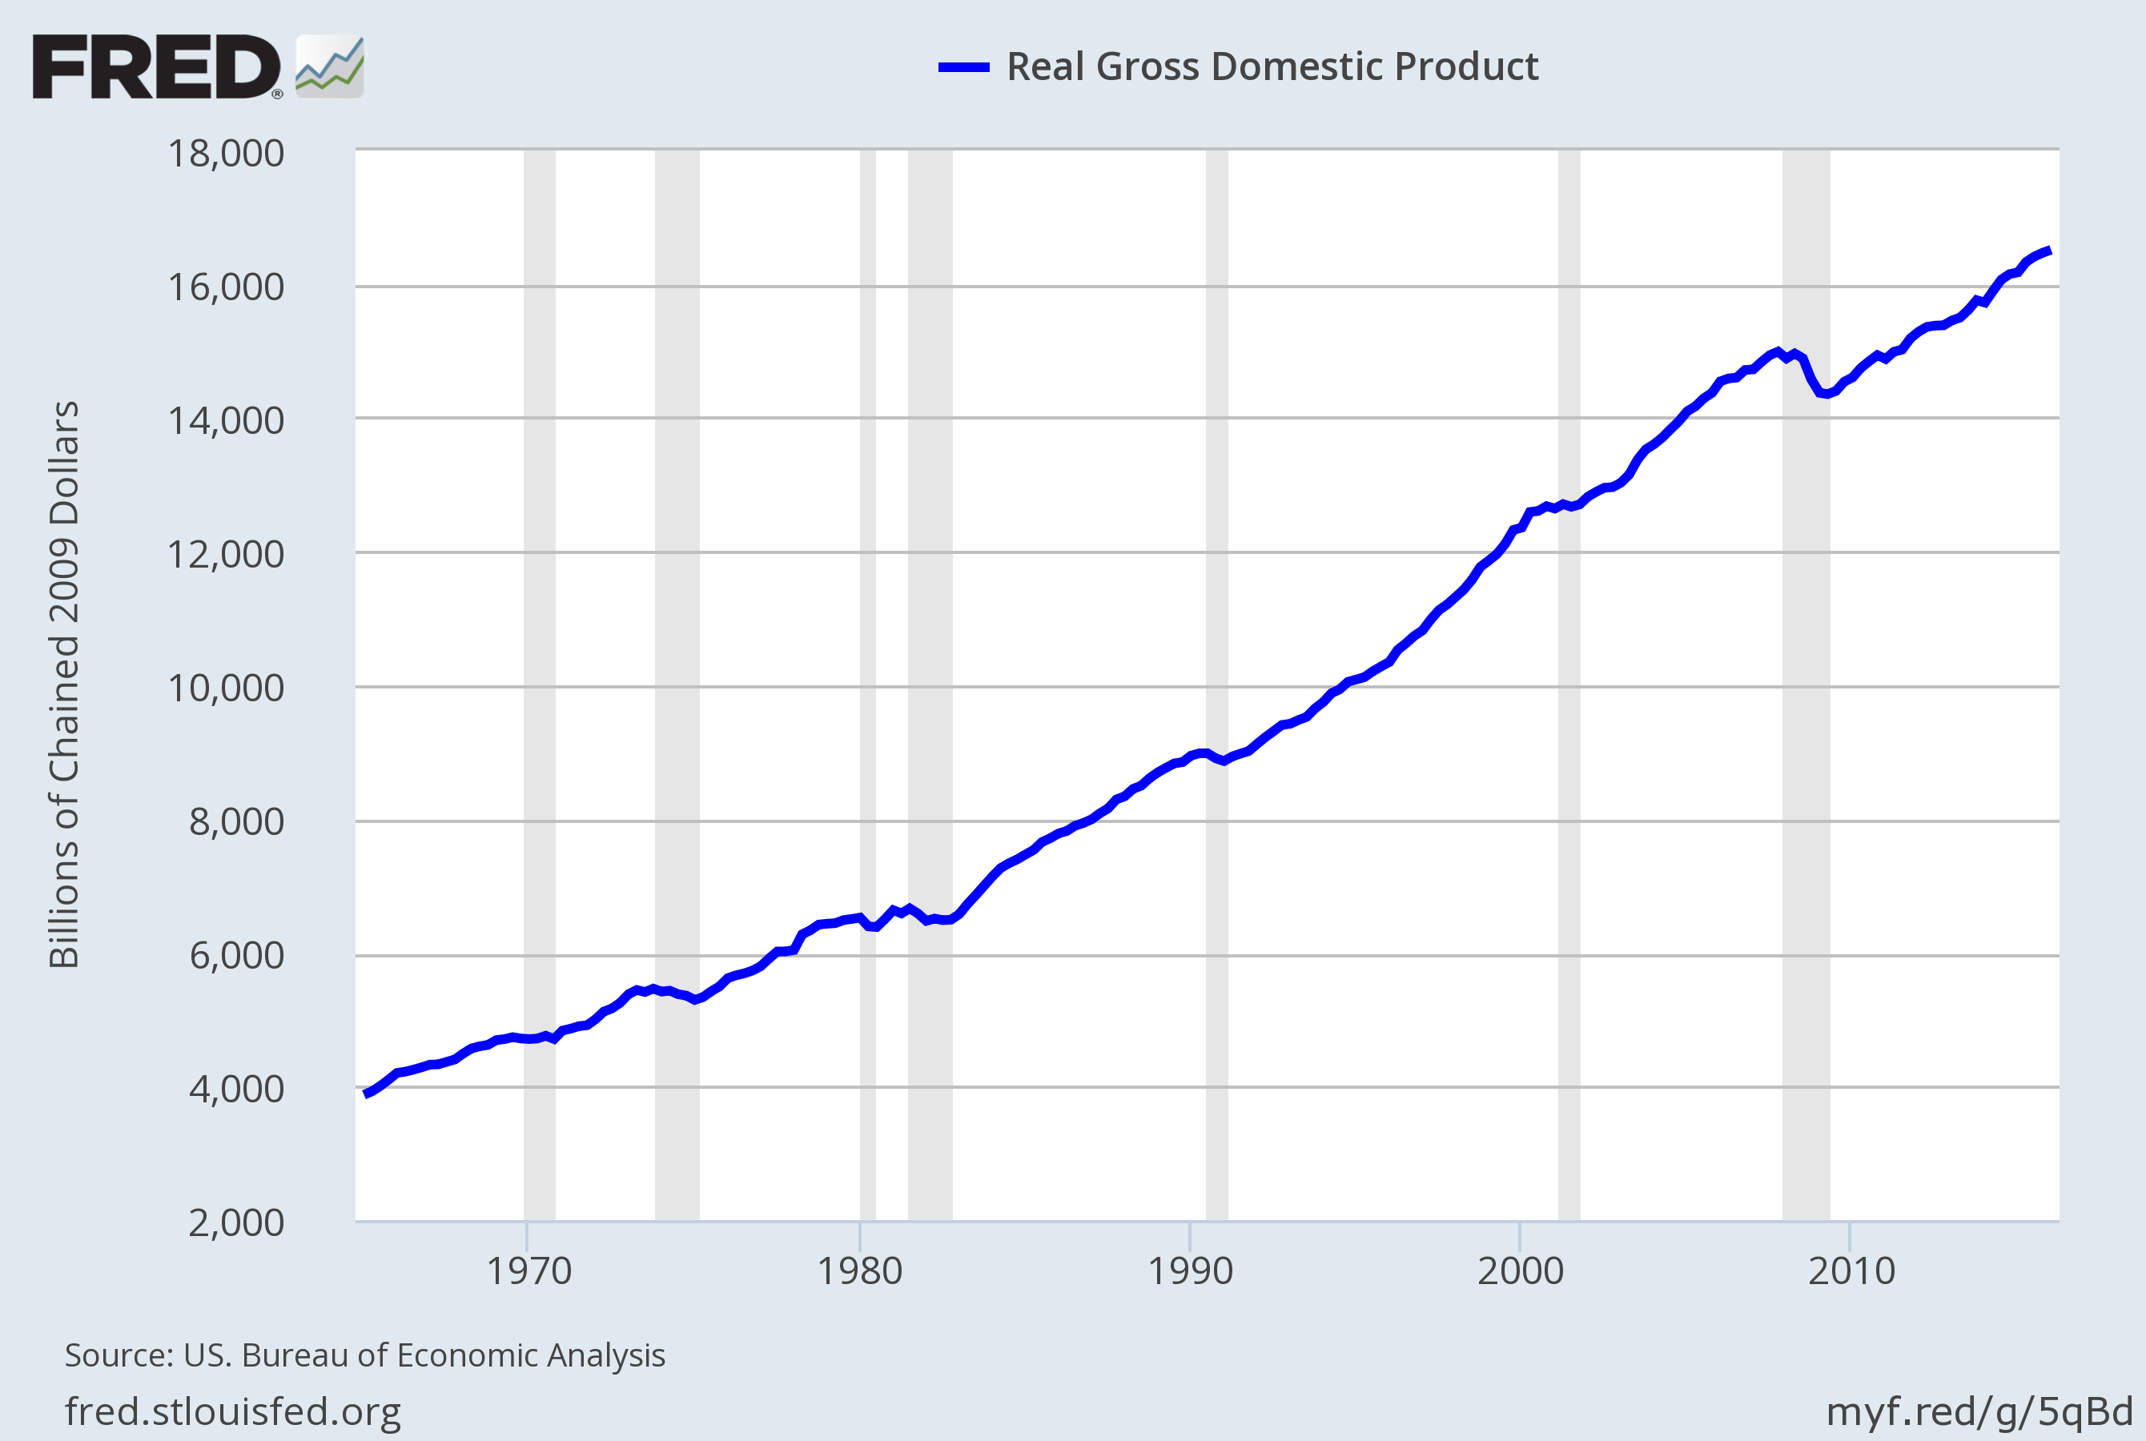
Three Facts About Economic Fluctuations
FACT 1: Economic fluctuations are irregular and unpredictable
Notes:
U.S. real GDP, billions of 2009 dollars, 1965 – 2015.
Recessions (represented by the shaded bars) are of different durations and do not occur with any regularity. Hence, the common term “business cycle” is a bit misleading, as “cycle” implies something more regular and predictable.
ORIGINAL SOURCE: U.S. Department of Commerce, Bureau of Economic Analysis
Website where I found this data: http://research.stlouisfed.org/fred2/
SERIES: GDPC1
Updated data and graph at: https://fred.stlouisfed.org/graph/?g=5qB5 (download the graph as PowerPoint and copy-paste the figure)

Slide 6
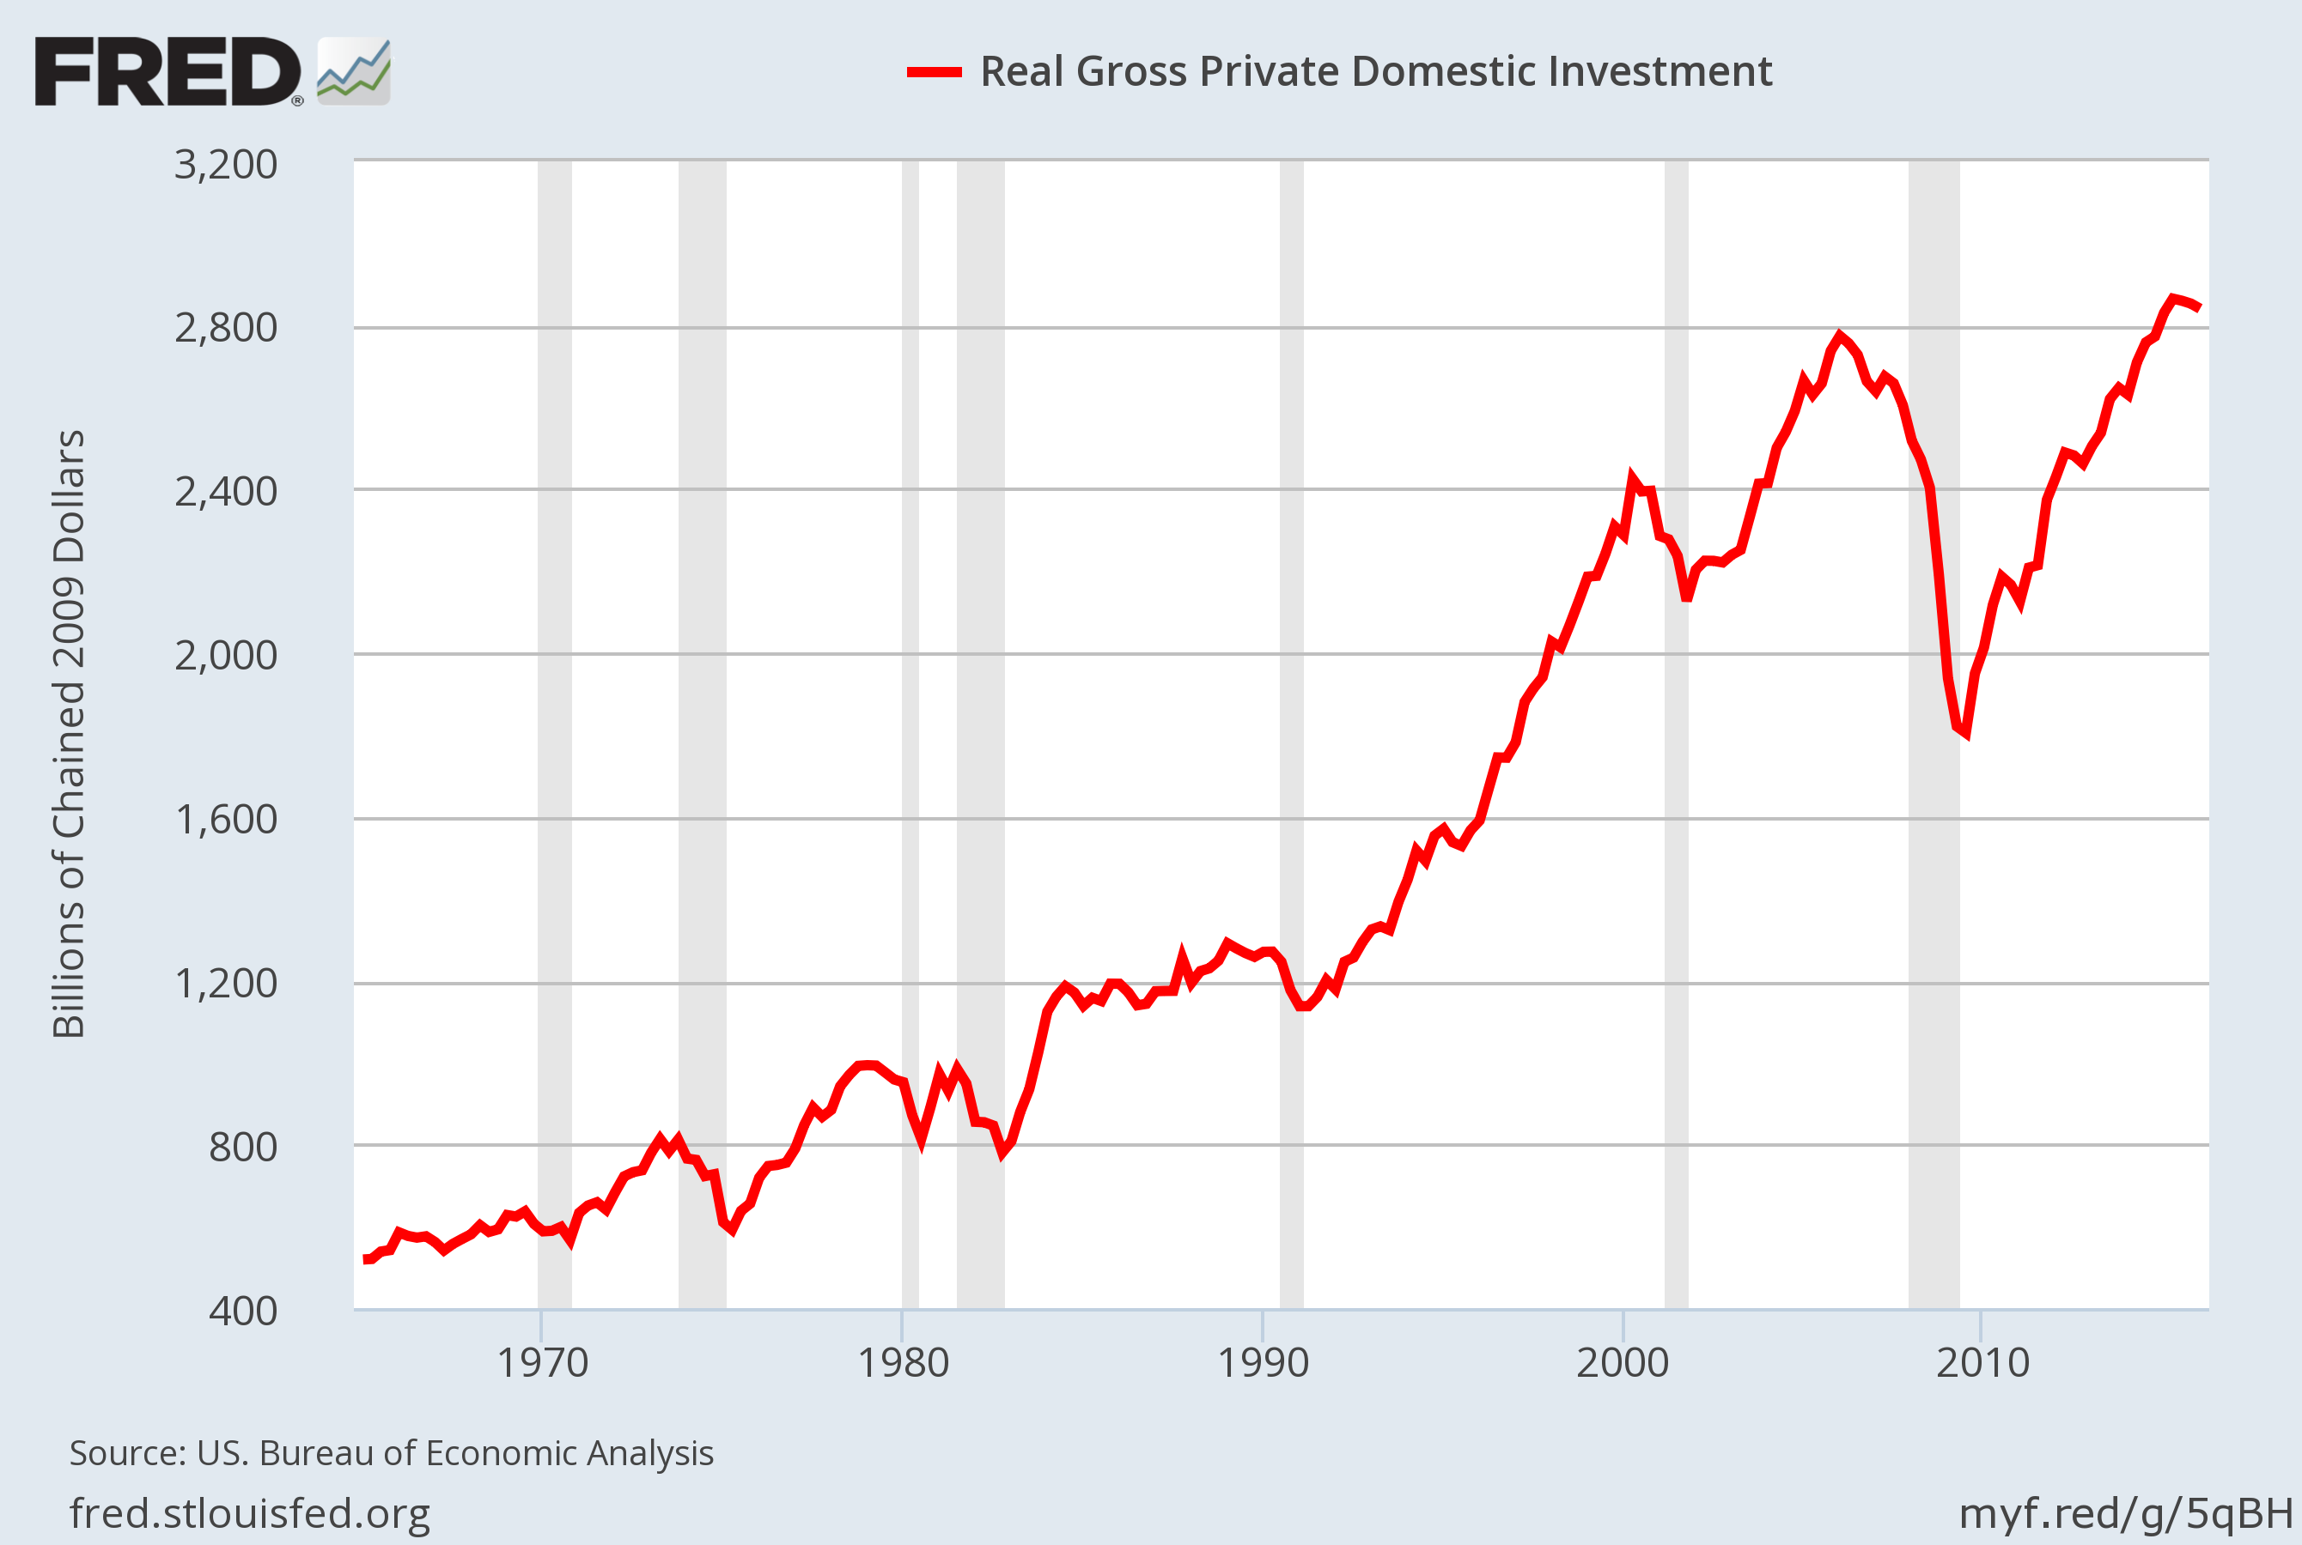
Three Facts About Economic Fluctuations
FACT 2: Most macroeconomic quantities fluctuate together.
Notes:
Investment spending, billions of 2009 dollars, 1965-2015.
Point out that investment falls during each recession. This is true of other variables as well: When the economy is in recession, incomes fall, consumer spending falls, profits fall, many stock prices fall, tax revenue falls (causing the budget deficit to rise), and spending on imports falls (causing the trade deficit to shrink).
ORIGINAL SOURCE: U.S. Department of Commerce, Bureau of Economic Analysis
Website where I found this data: http://research.stlouisfed.org/fred2/
SERIES NAME: GPDIC1
Updated data and graph at https://fred.stlouisfed.org/graph/?g=5qBG (download the graph as PowerPoint and copy-paste the figure)

Slide 7
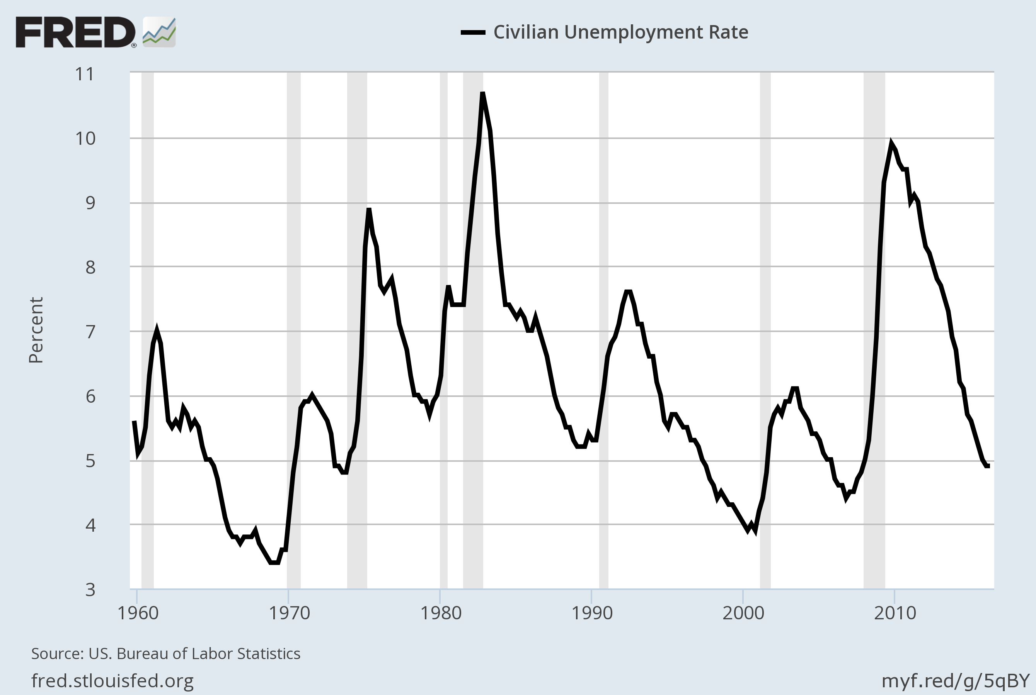
Three Facts About Economic Fluctuations
FACT 3: As output falls, unemployment rises.
Notes:
Unemployment rate, percent of labor force, 1965-2015.
During each recession, the unemployment rate rises. When firms cut back on production, they don’t need as many workers. Similarly, during expansions, we see the unemployment rate falling—as firms increase their output, they need more workers.
ORIGINAL SOURCE: U.S. Department of Labor, Bureau of Labor Statistics
Website where I found this data: http://research.stlouisfed.org/fred2/ series “UNRATE” (quarterly, average, seasonally adjusted)
Updated data and graph at https://fred.stlouisfed.org/graph/?g=5qBX (download the graph as PowerPoint and copy-paste the figure)

Slide 8
Classical Economics—A Recap
Classical economics:
The Classical Dichotomy, the separation of variables into two groups:
Real – quantities, relative prices
Nominal – measured in terms of money
The neutrality of money: Changes in the money supply affect nominal but not real variables

Slide 9
Classical Economics—A Recap
Classical theory
Describes the world in the long run, but not the short run
Notes:
As in previous chapters, “u-rate” is short for unemployment rate.

Slide 10
AD-AS Model
AD-AS model
Model of aggregate demand (AD) and aggregate supply (AS)
Most economists use it to explain short-run fluctuations in economic activity
Around its long-run trend

Slide 11
Model of Aggregate Demand and Aggregate Supply
0
P
“Short-Run Aggregate Supply”
The price level
SRAS
The model determines the equilibrium price level
P₁
AD
“Aggregate Demand”
Y
Y₁
and equilibrium output (real GDP).
Real GDP, the quantity of output
Notes:
11
Suggestion: Briefly explain each element of the graph as it appears. (Brief is appropriate because each element will be discussed carefully in the following slides.)
Note that the graph measures a nominal variable (P) on the vertical axis, and a real one (Y) on the horizontal axis. Thus, the graph highlights the breakdown of the classical dichotomy.
If you are more of a micro person, then please disregard the following.
Still reading? Then you must be a macro person. Excellent! Here’s something you might tell your students. This model LOOKS like the basic supply and demand model from Chapter 4, but there’s a big difference. The basic supply & demand model determines the equilibrium price and quantity of a particular good, say, apples. The equilibrium price of apples is extremely important if you’re an apple grower. Ask your students to raise their hand if they plan on going into the apple-growing business. Chances are, none will raise their hands. The model of aggregate demand and supply, however, determines the equilibrium price and quantity of EVERYTHING (loosely speaking), i.e., the price level (cost of living) and real GDP (national income). So, the model of aggregate demand and aggregate supply is highly relevant to a broader group of people than just apple growers. How ’bout them apples!

Slide 12
The Aggregate-Demand (AD) Curve
0
The AD curve shows the quantity of all goods and services demanded in the economy at any given price level.
P
P₂
P₁
AD
Y
Y₂
Y₁
Notes:
12
As in previous chapters, “g&s” stands for “goods and services.”

Slide 13
Why the AD Curve Slopes Downward
0
Y = C + I + G + NX
Assume G is fixed by government policy.
To understand the slope of AD, must determine how a change in P affects C, I, and NX.
P
P₂
P₁
AD
Y
Y₂
Y₁
Y₁
Notes:
13

Slide 14
The Wealth Effect (P and C )
Suppose the price level, P, declines
Increase in the real value of money
Consumers are wealthier
Increase in consumer spending, C
Increase in quantity demanded of goods and services
Notes:
Note: the wealth effect concerns the impact of a change in P on wealth, not on income. When P falls, we are implicitly assuming that people’s real incomes are unchanged, and we are only considering the impact of the change in their real wealth on their consumption spending.
After all text on this slide has appeared, you might tell your students that this effect works in reverse, too: increase in P declines real wealth, which causes consumption to drop.

Slide 15
The Interest-Rate Effect (P and I)
Suppose the price level, P, declines
Buying goods and services requires fewer dollars
People buy bonds and other assets
Decrease in the interest rate
Increase spending on investment goods, I
Increase in quantity demanded of goods and services
Notes:
Again, we are holding real income (and everything else) constant.

Slide 16
The Exchange-Rate Effect (P and NX )
Suppose the U.S. price level, P, declines
Decrease in the interest rate
U.S. dollar depreciates
Stimulates U.S. net exports, NX
Increase in quantity demanded of goods and services

Slide 17
The Slope of the AD Curve: Summary
0
An increase in P reduces the quantity of goods and services demanded because:
the wealth effect (C falls)
the interest-rate effect (I falls)
the exchange-rate effect (NX falls)
P
P₂
P₁
AD
Y
Y₂
Y₁
Notes:
17

Slide 18
Why the AD Curve Might Shift
0
Any event that changes C, I, G, or NX—except a change in P—will shift the AD curve.
Example: A stock market boom makes households feel wealthier, C rises, the AD curve shifts right.
P
P₁
AD₂
AD₁
Y
Y₁
Y₂
Notes:
18
A change in P won’t shift the AD curve, but will cause a movement along the AD curve.

Slide 19
Why the AD Curve Might Shift
Changes in C
Stock market boom/crash
Preferences re: consumption/saving tradeoff
Tax hikes/cuts
Changes in I
Firms buy new computers, equipment, factories
Expectations, optimism/pessimism
Interest rates,
Monetary policy,
Investment Tax Credit or other tax incentives

Slide 20
Why the AD Curve Might Shift
Changes in G
Federal spending, e.g., defense
State & local spending, e.g., roads, schools
Changes in NX
Booms/recessions in countries that buy our exports
Appreciation/depreciation resulting from international speculation in foreign exchange market

Slide 21
Active Learning 1 The Aggregate-Demand curve
What happens to the AD curve in each of the following scenarios?
A ten-year-old investment tax credit expires.
The U.S. exchange rate falls.
A fall in prices increases the real value of consumers’ wealth.
State governments replace their sales taxes with new taxes on interest, dividends, and capital gains.
Notes:
Suggestion: Have your students draw a separate diagram of the AD curve for each scenario and show on the diagram what happens to the curve.

Slide 22
Active Learning 1
A ten-year-old investment tax credit expires.
I falls, AD curve shifts left.
The U.S. exchange rate falls.
A fall in prices increases the real value of consumers’ wealth.
State governments replace their sales taxes with new taxes on interest, dividends, and capital gains.

Slide 23
Active Learning 1
A ten-year-old investment tax credit expires.
I falls, AD curve shifts left.
The U.S. exchange rate falls.
NX rises, AD curve shifts right.
A fall in prices increases the real value of consumers’ wealth.
State governments replace their sales taxes with new taxes on interest, dividends, and capital gains.

Slide 24
Active Learning 1
A ten-year-old investment tax credit expires.
I falls, AD curve shifts left.
The U.S. exchange rate falls.
NX rises, AD curve shifts right.
A fall in prices increases the real value of consumers’ wealth.
Move down along AD curve (wealth-effect).
State governments replace their sales taxes with new taxes on interest, dividends, and capital gains.

Slide 25
Active Learning 1
A ten-year-old investment tax credit expires.
I falls, AD curve shifts left.
The U.S. exchange rate falls.
NX rises, AD curve shifts right.
A fall in prices increases the real value of consumers’ wealth.
Move down along AD curve (wealth-effect).
State governments replace their sales taxes with new taxes on interest, dividends, and capital gains.
C rises, AD shifts right.

Slide 26
Active Learning 1
A ten-year-old investment tax credit expires.
I falls, AD curve shifts left.
The U.S. exchange rate falls.
NX rises, AD curve shifts right.
A fall in prices increases the real value of consumers’ wealth.
Move down along AD curve (wealth-effect).
State governments replace their sales taxes with new taxes on interest, dividends, and capital gains.
C rises, AD shifts right.

Slide 27
The Aggregate-Supply (AS ) Curves
0
The AS curve shows the total quantity of goods and services firms produce and sell at any given price level.
AS is:
upward-sloping in short run
vertical in long run
P
LRAS
SRAS
Y
Notes:
27

Slide 28
The Long-Run Aggregate-Supply Curve (LRAS)
0
The natural rate of output (Y_{N}) is the amount of output the economy produces when unemployment is at its natural rate.
Also called
potential output or full-employment output.
P
LRAS
Y
Y_{N}
Notes:
28

Slide 29
Why LRAS Is Vertical
0
Y_{N} determined by the economy’s stocks of labor, capital, and natural resources, and on the level of technology.
An increase in P
does not affect any of these, so it does not affect Y_{N}.
(Classical dichotomy)
P
LRAS
P₂
P₁
Y
Y_{N}
Notes:
29

Slide 30
Why the LRAS Curve Might Shift
0
Any event that changes any of the determinants of Y_{N} will shift LRAS.
Example: Immigration increases L, causing Y_{N} to rise.
P
LRAS₁
LRAS₂
Y
Y_{N}
’
Y_{N}
Notes:
30

Slide 31
Why the LRAS Curve Might Shift
Changes in L or natural rate of unemployment
Immigration
Baby-boomers retire
Government policies reduce natural u-rate
Changes in K or H
Investment in factories, equipment
More people get college degrees
Factories destroyed by a hurricane
Notes:
Remember: L = labor; K = capital, H = human capital

Slide 32
Why the LRAS Curve Might Shift
Changes in natural resources
Discovery of new mineral deposits
Reduction in supply of imported oil
Changing weather patterns that affect agricultural production
Changes in technology
Productivity improvements from technological progress

Slide 33
Using AD & AS to Depict Long-Run Growth & Inflation
0
Over the long run, tech. progress shifts LRAS to the right
and growth in the money supply shifts AD to the right.
Result: ongoing inflation and growth in output.
LRAS₂₀₁₀
P
LRAS₂₀₀₀
LRAS₁₉₉₀
P₂₀₁₀
P₂₀₀₀
AD₂₀₁₀
P₁₉₉₀
AD₂₀₀₀
AD₁₉₉₀
Y
Y₁₉₉₀
Y₂₀₀₀
Y₂₀₁₀
Notes:
33

Slide 34
Short Run Aggregate Supply (SRAS)
0
The SRAS curve is upward sloping:
Over the period of 1–2 years, an increase in P
causes an increase in the quantity of goods and services supplied.
P
SRAS
P₂
P₁
Y
Y₁
Y₂
Notes:
34

Slide 35
Why the Slope of SRAS Matters
0
If AS is vertical, fluctuations in AD do not cause fluctuations in output or employment.
If AS slopes up, then shifts in AD do affect output and employment.
LRAS
P
P_{hi}
SRAS
P_{hi}
AD_{hi}
P_{lo}
AD₁
P_{lo}
AD_{lo}
Y
Y_{lo}
Y₁
Y_{hi}
Notes:
35
Before introducing the three theories of short-run aggregate supply, it’s worth taking a moment to show students why the slope of SRAS is critically important in the theory of economic fluctuations.

Slide 36
Three Theories of SRAS
Theories that explain why the AS curve slopes upward in short-run:
Sticky-wage theory
Sticky-price theory
Misperceptions theory
In each, some type of market imperfection: Output deviates from its natural rate when the actual price level deviates from the price level people expected.
Notes:
Each of these theories provides a reason why the aggregate supply curve might have a positive slope in the short run.
It would be most helpful if students carefully read this section of the chapter!

Slide 37
1. The Sticky-Wage Theory
Imperfection:
Nominal wages are sticky in the short run, they adjust sluggishly.
Due to labor contracts, social norms
Firms and workers set the nominal wage in advance based on P_{E}, the price level they expect to prevail.

Slide 38
1. The Sticky-Wage Theory
If P > P_{E},
Revenue is higher, but labor cost is not.
Production is more profitable, so firms increase output and employment.
Hence, higher P causes higher Y, so the SRAS curve slopes upward.
Notes:
“If P > PE” means “If the actual price level turns out to be higher than the price level firms had expected...”

Slide 39
2. The Sticky-Price Theory
Imperfection:
Many prices are sticky in the short run.
Due to menu costs, the costs of adjusting prices.
Examples: cost of printing new menus, the time required to change price tags
Firms set sticky prices in advance based on P_{E}

Slide 40
2. The Sticky-Price Theory
Suppose the Fed increases the money supply unexpectedly
In the long run, P will rise
In the short run:
Firms without menu costs can raise their prices immediately
Firms with menu costs wait to raise prices. With relatively low prices: increase demand for their products: increase output and employment
Hence, higher P is associated with higher Y, so the SRAS curve slopes upward.

Slide 41
3. The Misperceptions Theory
Imperfection:
Firms may confuse changes in P with changes in the relative price of the products they sell.
If P rises above P_{E}
A firm sees its price rise before realizing all prices are rising.
The firm may believe its relative price is rising, and may increase output and employment.
So, an increase in P can cause an increase in Y, making the SRAS curve upward-sloping.

Slide 42
What the 3 Theories Have in Common:
In all 3 theories, Y deviates from Y_{N} when P deviates from P_{E}.
Y = Y_{N} + a (P – P_{E})
Output
Expected price level
Natural rate of output (long-run)
a > 0, measures how much Y responds to unexpected changes in P
Actual price level

Slide 43
What the 3 Theories Have in Common:
Y = Y_{N} + a (P – P_{E})
0
P
SRAS
When P > P_{E}
the expected price level
P_{E}
When P < P_{E}
Y
Y_{N}
Y < Y_{N}
Y > Y_{N}
Notes:
43
When P = P_{E}, Y = Y_{N}
When P < P_{E}, Y < Y_{N}
When P > P_{E}, Y > Y_{N}

Slide 44
SRAS and LRAS
The imperfections in these theories are temporary. Over time,
Sticky wages and prices become flexible
Misperceptions are corrected
In the LR,
P_{E} = P
AS curve is vertical

Slide 45
SRAS and LRAS
0
Y = Y_{N} + a (P – P_{E})
In the long run, P_{E} = P
and Y = Y_{N}.
P
LRAS
SRAS
P_{E}
Y
Y_{N}
Notes:
45

Slide 46
Why the SRAS Curve Might Shift
0
Everything that shifts LRAS shifts SRAS, too.
Also, P_{E} shifts SRAS:
If P_{E} rises,
workers & firms set higher wages.
At each P, production is less profitable, Y falls, SRAS shifts left.
P
LRAS
SRAS
SRAS
P_{E}
P_{E}
Y
Y_{N}
Notes:
46

Slide 47
The Long-Run Equilibrium
0
In the long-run equilibrium,
P_{E} = P,
Y = Y_{N} ,
and unemployment is at its natural rate.
P
LRAS
SRAS
P_{E}
AD
Y
Y_{N}
Notes:
47

Slide 48
Economic Fluctuations
Four steps to analyzing economic fluctuations:
Determine whether the event shifts AD or AS.
Determine whether curve shifts left or right.
Use AD–AS diagram to see how the shift changes Y and P in the short run.
Use AD–AS diagram to see how economy moves from new SR equilibrium to new LR equilibrium .
Notes:
To study economic fluctuations caused by events that shift the AD and/or AS curves, we use the four-step approach based on the three-step approach used in Chapter 4 to analyze changes in the basic supply & demand model.

Slide 49
The Effects of a Shift in AD
0
Event: Stock market crash
1. Affects C, AD curve
2. C falls, so AD shifts left
3. SR equilibrium at B. P and Y lower, unemployment higher
4. Over time, P_{E} falls, SRAS shifts right, until LR equilibrium at C. Y and unemployment back at initial levels.
P
LRAS
SRAS₁
P₁
A
SRAS₂
P₂
B
AD₁
P₃
C
AD₂
Y
Y₂
Y_{N}
Notes:
49

Slide 50
Two Big AD Shifts: 1.The Great Depression
From 1929–1933, money supply fell 28% due to problems in banking system
stock prices fell 90%, reducing C and I
Y fell 27%
P fell 22%
Unemployment rate rose from 3% to 25%
U.S. Real GDP, billions of 2000 dollars
Notes:
Two possible causes of the Great Depression: the fall in the money supply, and the stock market crash. Either would shift the AD curve left, causing P and Y to fall and causing unemployment to rise.
Data source: Bureau of Economic Analysis, U.S. Department of Commerce
http://www.bea.doc.gov/bea/dn/home/gdp.htm

Slide 51
Two Big AD Shifts: 2.The World War II Boom
From 1939–1944,
government outlays rose from $9.1 billion to $91.3 billion
Y rose 90%
P rose 20%
unemployment fell from 17% to 1%
U.S. Real GDP, billions of 2000 dollars
Notes:
This boom was clearly caused by a surge in govt spending. Our model predicts an increase in G would shift AD to the right, increasing P and Y, and reducing unemployment. These predictions are consistent with the data.
Source for GDP data: Bureau of Economic Analysis, U.S. Department of Commerce
http://www.bea.doc.gov/bea/dn/home/gdp.htm
Source for data on government outlays: Economic Report of the President, 2005 edition, Table B-78. http://www.gpoaccess.gov/eop/

Slide 52
Active Learning 2 Working with the model
Draw the AD-SRAS-LRAS diagram for the U.S. economy starting in a long-run equilibrium.
A boom occurs in Canada. Use your diagram to determine the SR and LR effects on U.S. GDP, the price level, and unemployment.

Slide 53
Active Learning 2
Event: Boom in Canada
Affects NX, AD curve
Shifts AD right
SR equilibrium at point B. P and Y higher, unemployment lower
Over time, P rises, SRAS shifts left, until LR equilibrium at C. Y and unemployment back at initial levels.
P
LRAS
SRAS₂
P₃
C
SRAS₁
P₂
B
P₁
A
AD₂
AD₁
Y
Y_{N}
Y₂

Slide 54
The Effects of a Shift in SRAS
0
Event: Oil prices rise
1. Increases costs, shifts SRAS (assume LRAS constant)
2. SRAS shifts left
3. SR equilibrium at point B. P higher, Y lower, unemployment higher
From A to B, stagflation, a period of falling output and rising prices.
P
LRAS
SRAS₂
SRAS₁
B
P₂
P₁
A
AD₁
Y
Y₂
Y_{N}
Notes:
54
An increase in oil prices might also affect LRAS. For simplicity, and to be consistent with the textbook, we assume it only affects the SRAS curve.

Slide 55
Accommodating an Adverse Shift in SRAS
0
If policymakers do nothing,
Low employment causes wages to fall, SRAS shifts right, until LR equilibrium at A.
Or, policymakers could use fiscal or monetary policy to increase AD and accommodate the AS shift:
Y back to Y_{N}, but P permanently higher.
P
LRAS
SRAS₂
P₃
C
SRAS₁
B
P₂
P₁
A
AD₂
AD₁
Y
Y₂
Y_{N}
Notes:
55

Slide 56
The 1970s Oil Shocks and Their Effects
0
1973–75
1978–80
Real oil prices
+ 138%
+ 99%
CPI
+ 21%
+ 26%
Real GDP
– 0.7%
+ 2.9%
# of unemployed persons
+ 3.5 million
+ 1.4 million
Notes:
56
The first oil shock: 1973–75
Oil prices more than doubled in just two years, causing SRAS to shift leftward. As our model predicts, the price level rose, GDP fell, and unemployment rose.
From 1975 to 1978, oil prices rose at less than the rate of inflation, the number of unemployed persons fell by 1.7 million, and real GDP grew by 16%. The economy was self-correcting.
But just when things were getting better, the second oil shock hit. Oil prices doubled, due in part to a revolution in Iran in 1979. Again, as our model predicts, SRAS shifted left, inflation rose, and unemployment increased. The table shows that real GDP rose 2.9% during this period—but remember, this is not an annual rate, it is 2.9% for the entire period, which is substantially below the long-run average growth rate of about 3% per year.
Data sources:
CPI and unemployment: Bureau of Labor Statistics, http://www.bls.gov
GDP and oil prices: FRED database, Federal Reserve Bank of St Louis, http://research.stlouisfed.org/fred2/

Slide 57

John Maynard Keynes, 1883–1946
The General Theory of Employment, Interest, and Money, 1936
Argued recessions and depressions
can result from inadequate demand;
policymakers should shift AD.
Famous critique of classical theory:
The long run is a misleading guide to
current affairs. In the long run, we are all dead. Economists set themselves too easy, too useless a task if in tempestuous seasons they can only tell us when the storm is long past, the ocean will be flat.

Slide 58
Conclusion
This chapter has introduced the model of aggregate demand and aggregate supply
Helps explain economic fluctuations.
Keep in mind:
These fluctuations are deviations from the long-run trends explained by the models we learned in previous chapters.
In the next chapter
How policymakers can affect aggregate demand with fiscal and monetary policy.

Slide 59
Summary
Short-run economic fluctuations around long-run trends
Are irregular and largely unpredictable.
When recessions occur, real GDP and other measures of income, spending, and production fall, while unemployment rises.
Classical economic theory assumption: nominal variables such as the money supply and the price level do not influence real variables such as output and employment.
Accurate in the long run but not in the short run

Slide 60
Summary
Model of aggregate demand and aggregate supply
The output of goods and services and the overall level of prices adjust to balance aggregate demand and aggregate supply.
The aggregate-demand curve slopes downward:
The wealth effect
The interest-rate effect
The exchange-rate effect
Any event or policy that raises consumption, investment, government purchases, or net exports at a given price level increases aggregate demand.

Slide 61
Summary
Any event or policy that reduces consumption, investment, government purchases, or net exports at a given price level decreases aggregate demand.
The long-run aggregate-supply curve is vertical.
The quantity of goods and services supplied depends on the economy’s labor, capital, natural resources, and technology but not on the overall level of prices.
Three theories explain the upward slope of the short-run aggregate-supply curve.

Slide 62
Summary
Sticky-wage theory
Sticky-price theory
Misperceptions theory
All three theories imply that output deviates from its natural level when the actual price level deviates from the price level that people expected.
Shifts of short-run aggregate supply curve
Events that alter the economy’s ability to produce output
Causes of economic fluctuations
Shift in aggregate demand and aggregate supply

